Slide 1
Introduction to networking
TCP/IP Five-Layer Network Model
Joel Enrique Esparza Ramirez
Internet of Things

Slide 2
Lectures
1. Introduction to Networking
2. The Network Layer
3. The transport and application Layer
4. Wireless connections

Slide 3
Introduction to Networking
TCP/IP Five-Layer Network Model

Slide 4
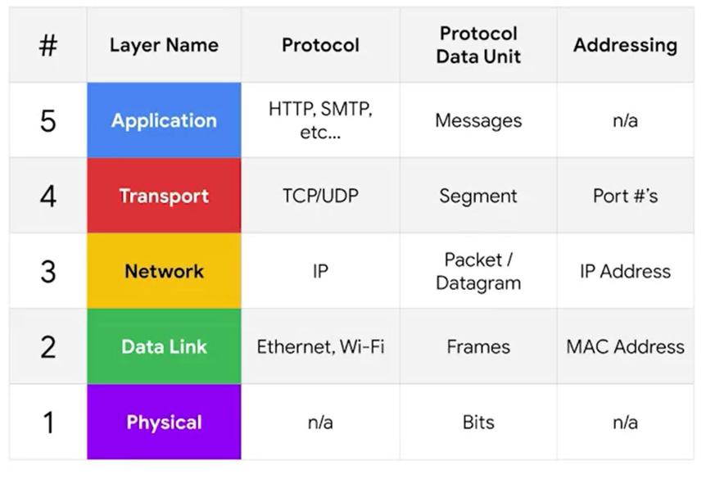
TCP/IP Five-Layer Network Model

Slide 5
Layer 1 physical
Represents the physical devices that interconnect computers

Slide 6
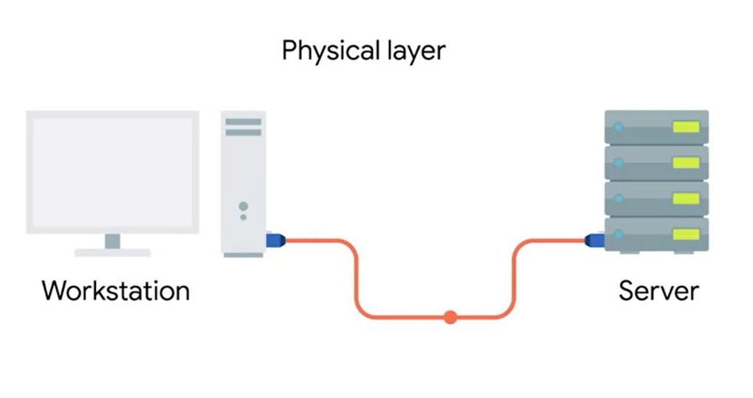

Slide 7
Layer 2 data link
Responsible for defining a common way of interesting these signals so network devices can communicate

Slide 8
ethernet
The Ethernet standards also define a protocol responsible for getting data to nodes on the same network

Slide 9
Layer 3 Network
Allows different networks to communicate with each other through devices known as routers

Slide 10
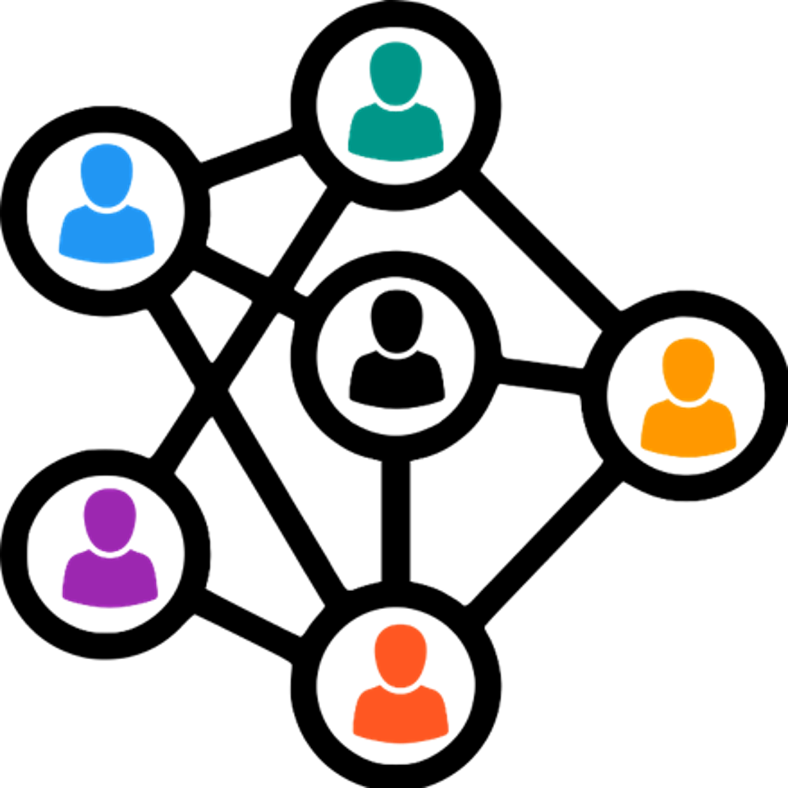

Slide 11
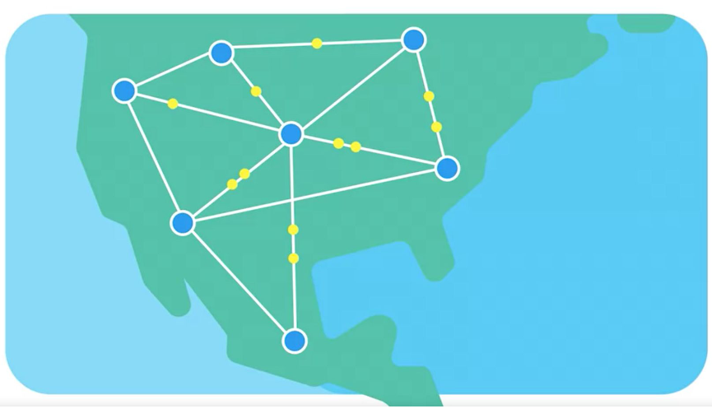

Slide 12
internetwork
A collection of networks connected together through routers, the most famous of these being the internet

Slide 13
Internet protocol
IP is the heart of the internet and most smaller networks around the world

Slide 14
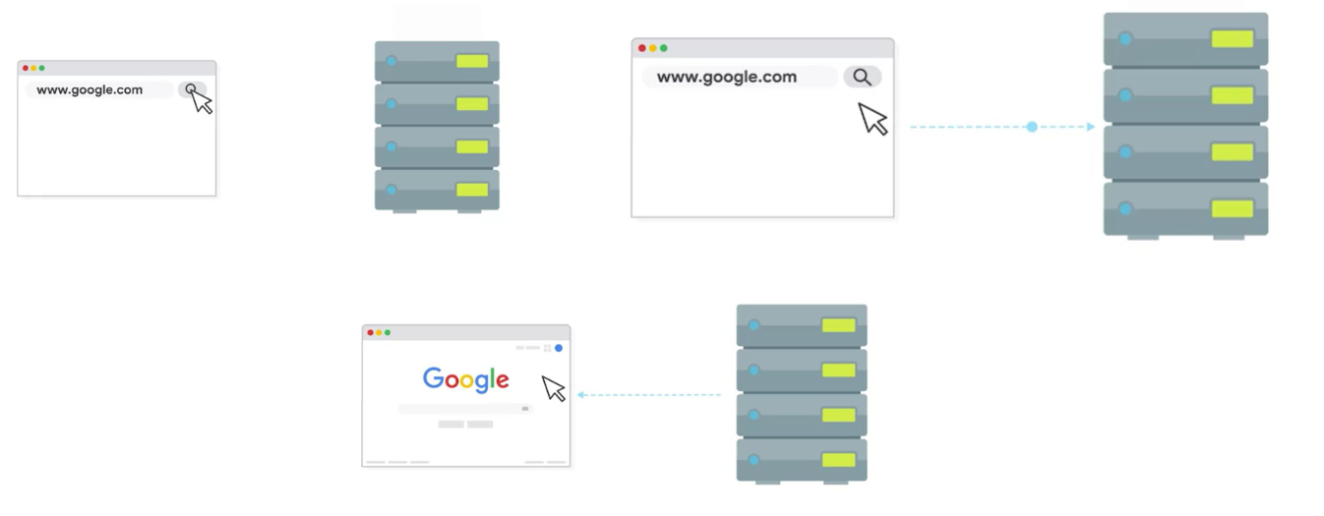
Client Server

Slide 15
Layer 4 transport
Sorts out which client and server programs are supposed to get that data

Slide 16
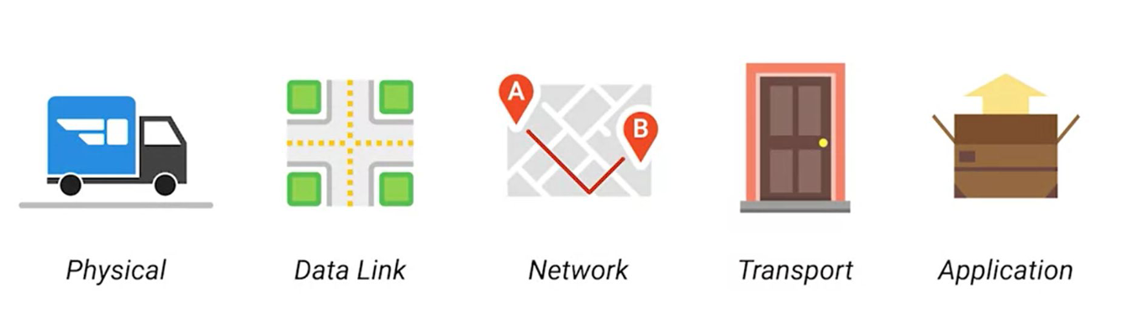

Slide 17
Osi model

Slide 18
Introduction to Networking
The basics of networking devices

Slide 19
cables
Connect different devices to each other, allowing data to be transmitted over them

Slide 20
Cables
Copper (Spanish)
Fiber (Spanish)

Slide 21
Cables
The most common forms of copper twisted-pair cables used in networking are Cat5, Cat5e and Cat6 cables

Slide 22
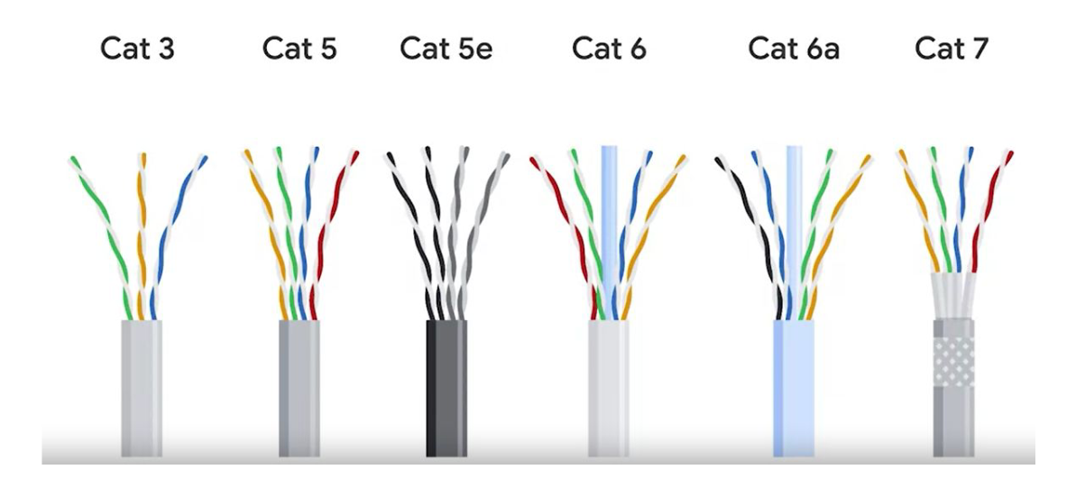

Slide 23
crosstalk
When an electrical pulse on one wire is accidentally detected on another wire

Slide 24
Fiber cables
Contain individual optical fibers, which are tiny tubes made out of glass about the width of a human hair

Slide 25
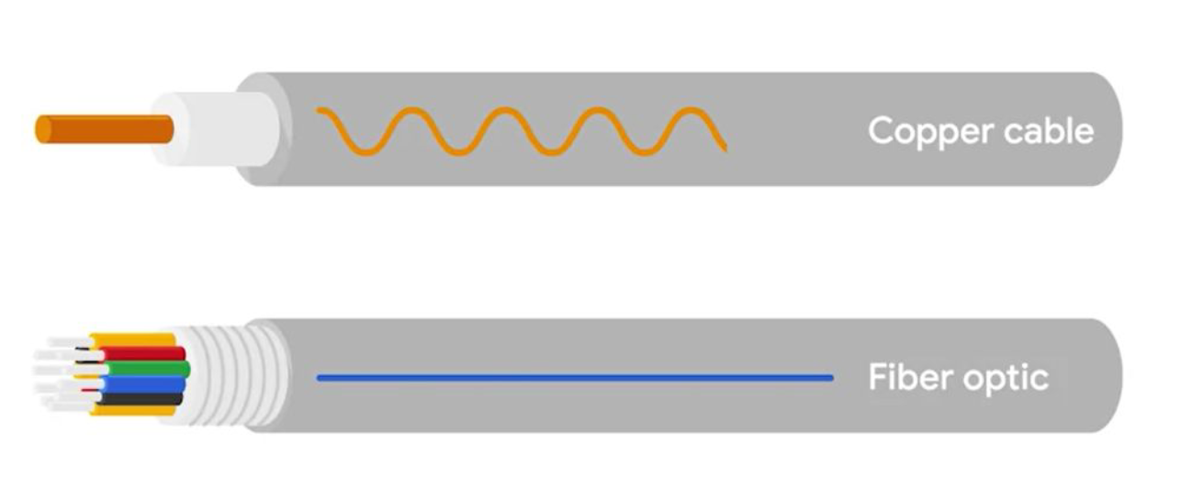

Slide 26
Recap layer 1

Slide 27
HUB
A physical layer device that allows for connections from many computers at once

Slide 28
HUB
A hub is a basic networking device that connects multiple computers or other network devices together. It operates at the physical layer (Layer 1) of the OSI model. When a data packet arrives at one port, it is copied to all other ports so that all segments of the LAN can see all packets.

Slide 29
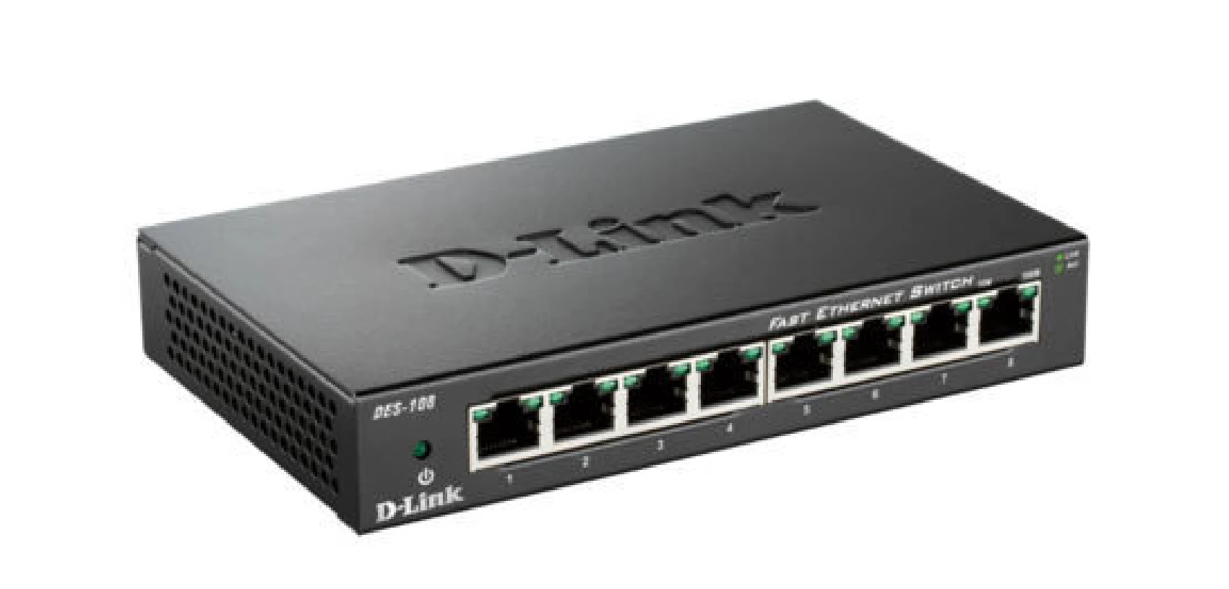

Slide 30
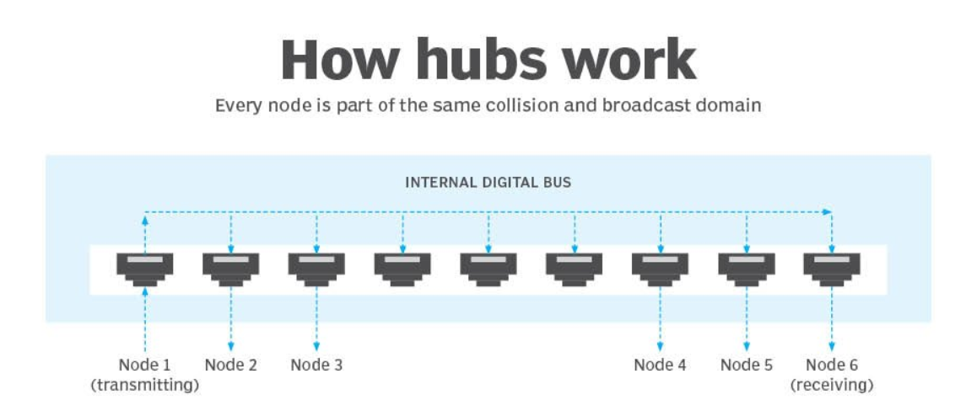

Slide 31
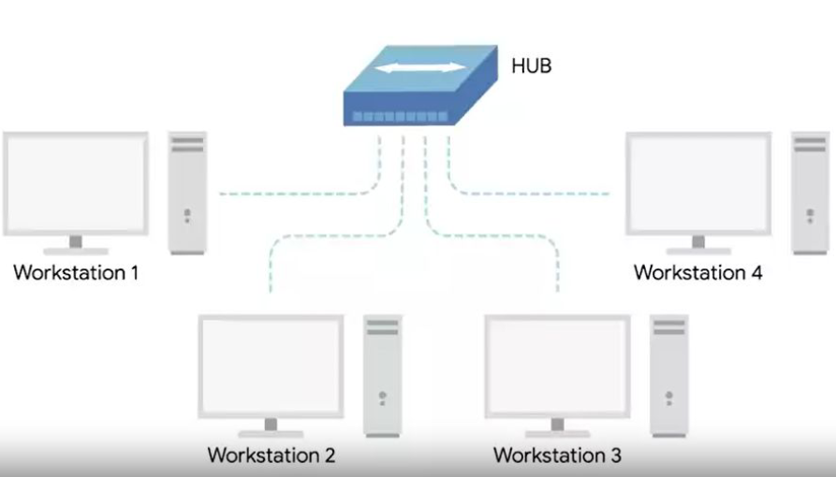

Slide 32
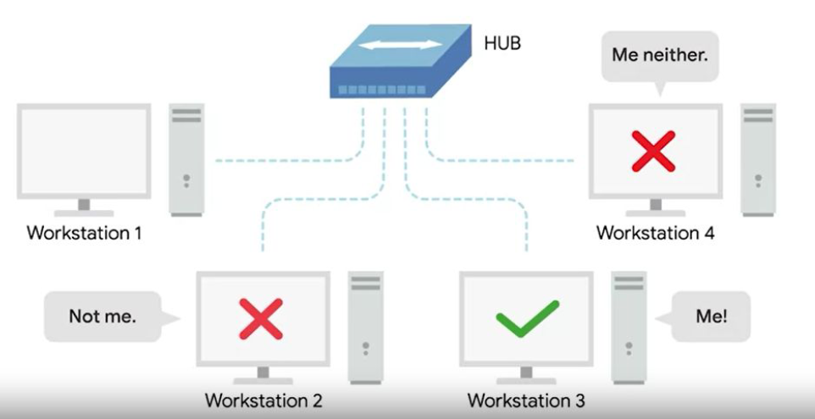

Slide 33
Collision domain
A network segment where only one device can communicate at a time

Slide 34
Collision domain
If multiple systems try sending data at the same time, the electrical pulses sent across the cable can interfere with each other

Slide 35
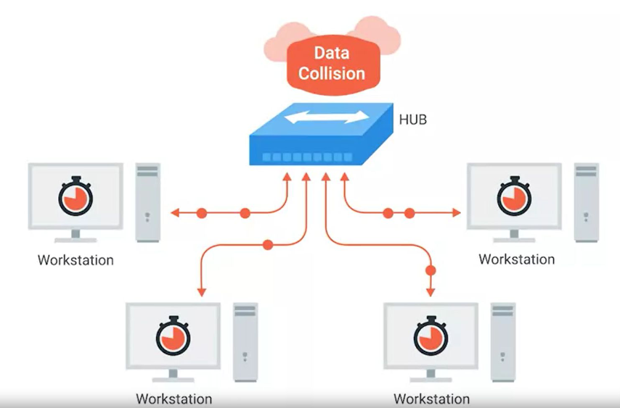

Slide 36
Switch
A switch, on the other hand, operates at the data link layer (Layer 2) of the OSI model. It is more advanced than a hub. A switch can inspect the data packets coming in and make decisions about where to send them based on their MAC addresses. Essentially, it can direct packets only to the device that is meant to receive them, rather than broadcasting to all devices.

Slide 37
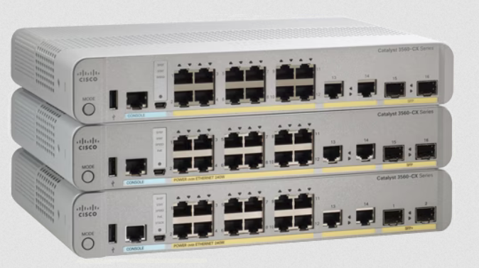
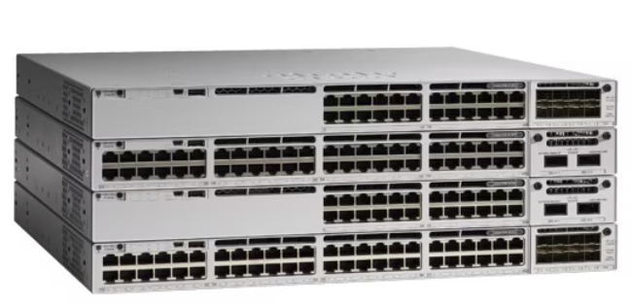

Slide 38
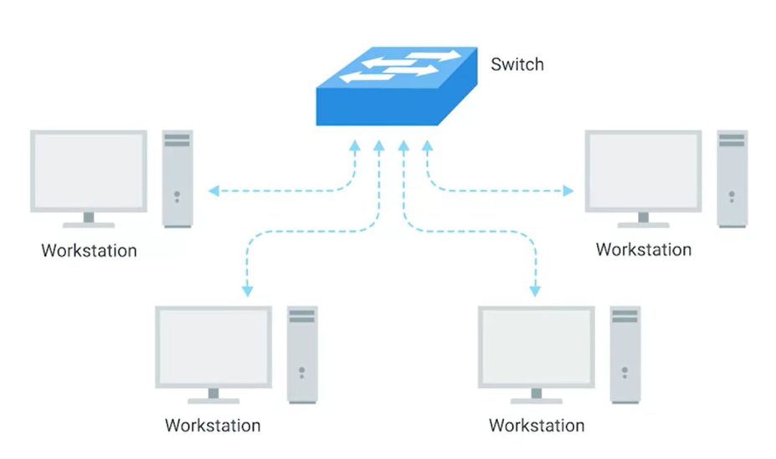

Slide 39
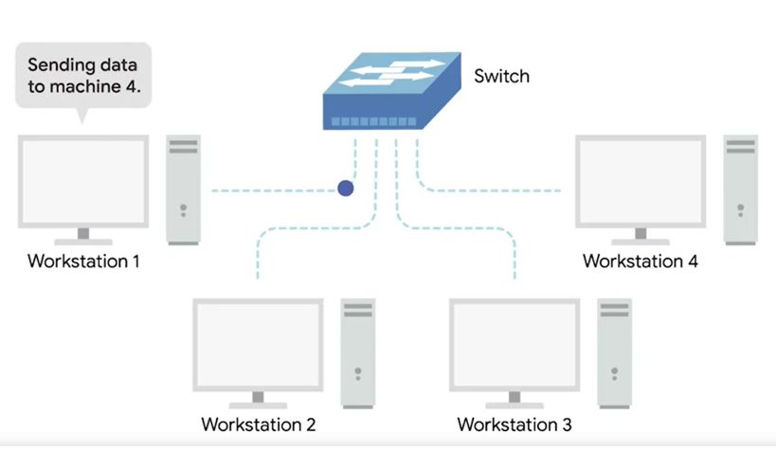

Slide 40
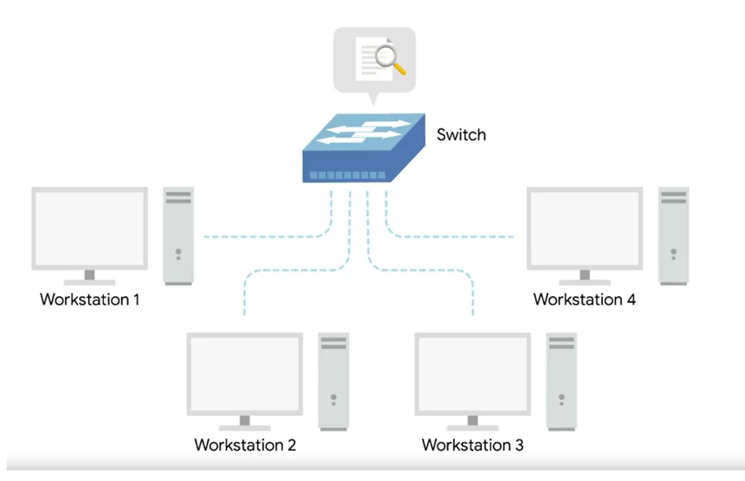

Slide 41
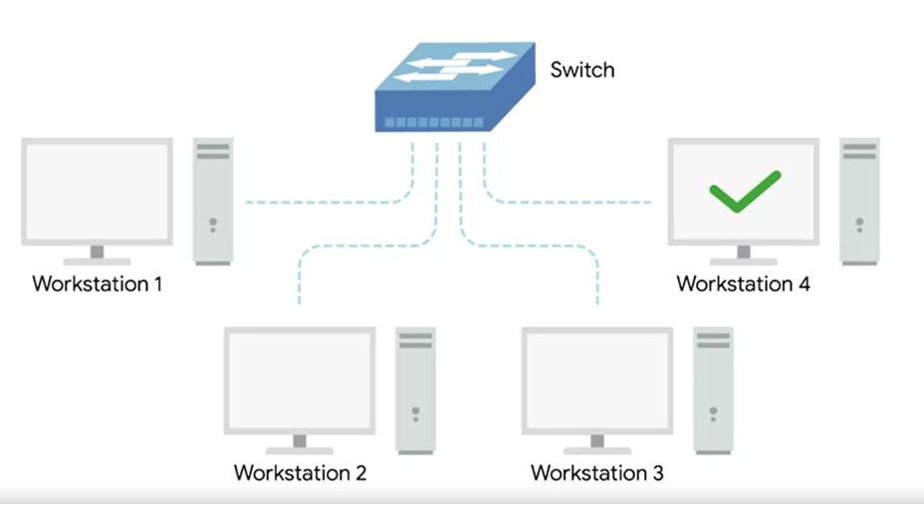

Slide 42
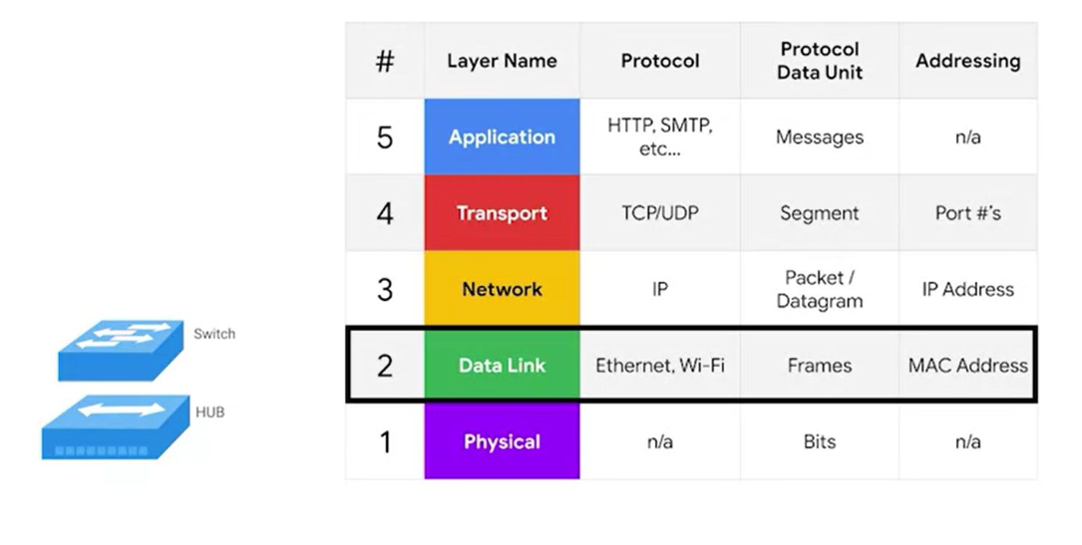

Slide 43
Hub and switches
The primary devices used to connect computers on a single network. Usually referred as a LAN, or local area network

Slide 44
recap

Slide 45
router
A device that knows how to forward data between independent networks

Slide 46
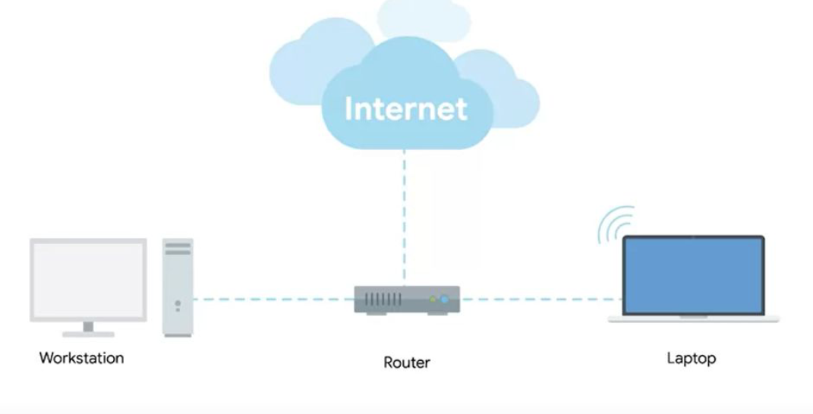

Slide 47
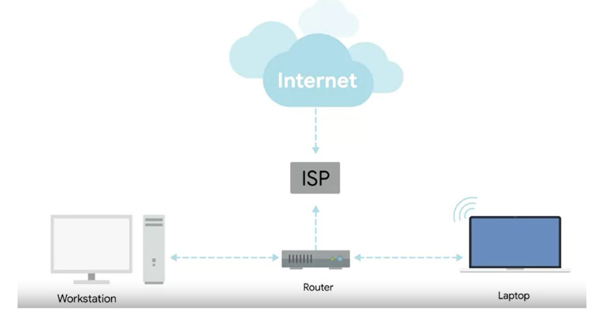
Internet service provider

Slide 49
Border gateway protocol (BGP)
Routers share data with each other via this protocol, which lets them learn about the most optimal paths to forward traffic.

Slide 50
NODE
A device connected to the network

Slide 51
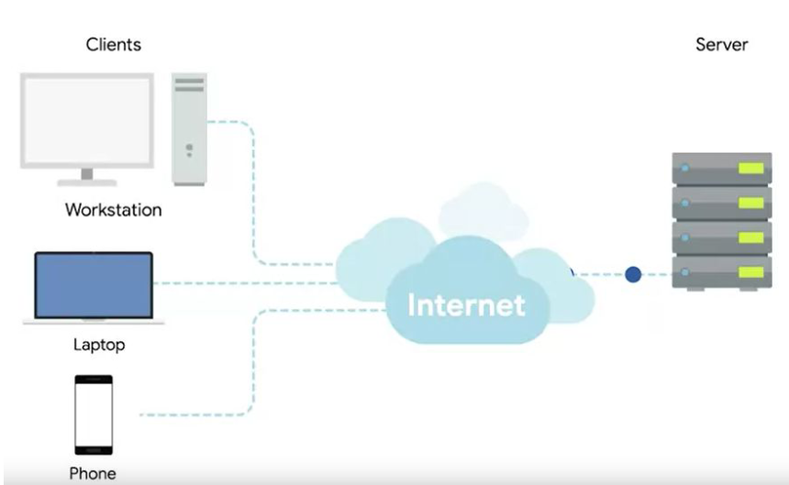

Slide 52
